Slide 1
Implementing and Evaluating MPTCP on the SCION Future Internet Architecture
Presentation master thesis
Michael A. Flückiger
August 28, 2020
Notes:
Welcome again
Happy that I today can present the work I did during my master thesis.

Slide 2
Projektanalyse – Folie 2
On the menu
Introduction
Functionality of Shila
Performance evaluation
Future work
Notes:
Let us start with an overview what I‘m going to cover in the next 30 minutes:
Start with the Introduction, where I will cover questions like:
What are the main ingredients of my work?
What was the goal of my work?
And why do we want to reach that goal?
During the Introduction I will furthermore introduce you to Shila – she plays an important role in my thesis.
After the Introduction I will then explain the functionality of Shila based on an example.
After that I will present some results of the performance evaluation I did and conclude the presentation with some references to future work.

Slide 3
Projektanalyse – Folie 2
On the menu
Introduction
Functionality of Shila
Performance evaluation
Future work
Notes:
So let’s start with the Introduction...

Slide 4
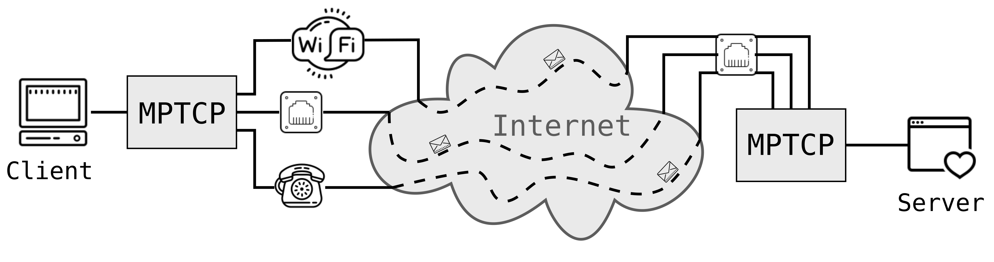
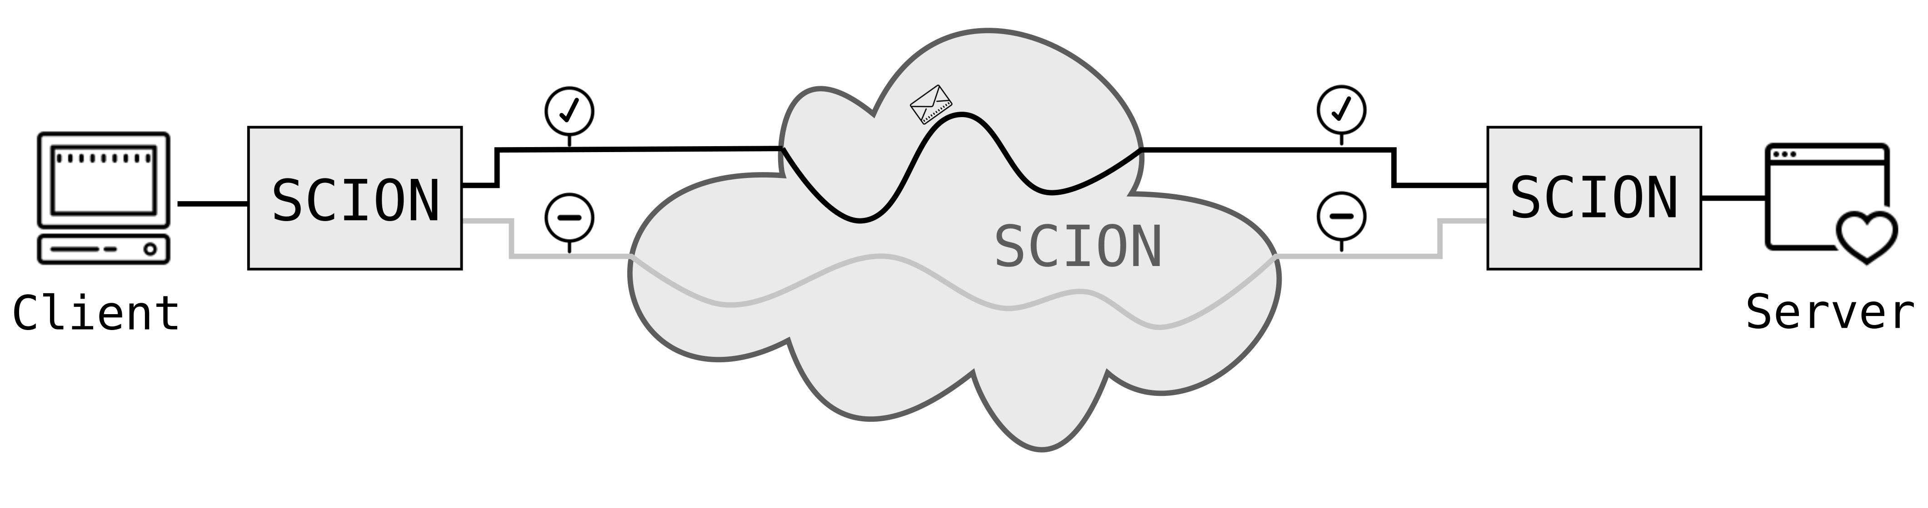
Projektanalyse – Folie 2
Introduction
Ingredients?
TCP (Transmission Control Protocol)
Dominant transport protocol in today’s Internet
One path per connection
MPTCP (Multipath TCP)
Extension to TCP
Multiple paths (flows) per connection
SCION (Scalability, Control and Isolation on next-generation networks)
More secure network architecture
Implements path transparency
Support for multiple paths
Notes:
As the title of the work suggests, it has two main ingredients: MPTCP and SCION.
On the one hand Multipath TCP, an extension to TCP, the famous transport protocol which I’m sure you all know.
In contrast to TCP supports MPTCP not one, but multiple paths (or flows) for a single connection.
As illustrated here in this Figure, for a single connection between client and server, it creates a separate flow for every available network interface.
On the other hand SCION: The successor of today’s Internet (hopefully ☺)
Im sure you all known this architecture too good. I therefore just want to mention two important points here:
SCION implements path transparency, sender and receiver know about the paths their data takes trough the network.
This contrasts with MPTCP where the sender and the receiver have no idea about the path their data takes through the network.
In the figure here this fact is illustrated with the dashed for MPTCP here, and the solid line for SCION.
The second point important for the presented work is the fact that SCION inherently provides support for multiple paths.

Slide 5
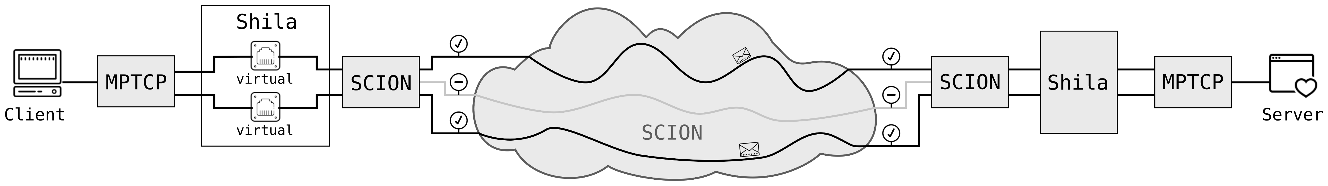
Projektanalyse – Folie 2
Introduction
What?
Main objective and contribution of the presented work:
Implementation (and evaluation) of a shim layer that
allows the usage of MPTCP over SCION.
Notes:
Knowning about our main ingredients, we now can talk about the goal of this work:
The main objective and contribution of the presented work was the implementation and the evaluation of a shim
layer that allows the usage of MPTCP over SCION.
I gave the implementation the name Shila, short for shim layer.

Slide 6
Projektanalyse – Folie 2
Introduction
What?
Main objective and contribution of the presented work:
Implementation (and evaluation) of a Shim layer that
allows the usage of MPTCP over SCION.
Notes:
This image here shows why Shila deserves her name. She is placed right in between MPTCP and SCION, where she fulfills her mediating role between the two technlogies.
Strongly simplified works the shim layer as follows:
Shila creates virtual network interfaces and monitors them. A TCP client application uses one of these virtual interfaces for connection. Shila intercepts the MPTCP connection request and forwards it over the SCION network to the Shila instance at the receiving site. There the request is handed over back to MPTCP. From there its forwarded to the TCP server application.
No worries, I will explain the functionalty in more detail soon. But before that, I want to talk about why one is even interested in MPTCP over SCION.

Slide 7



Projektanalyse – Folie 2
Introduction
Why?
Facilitates promotion and development of SCION
Straightforward use TCP applications over SCION
Benefit for endpoints with MPTCP support
Increase of redundancy thanks to multiple paths
Potential through mediating role of Shila in between
Shila is aware and under control of paths used through SCION
Notes:
A first reason is simple but not less important.:
MPTCP facilitates the promotion and development of SCION. With Shila one can use its favorite TCP application without having
to change anything at its implementation. This lowers the hurdles to try out SCION..
Another reason is that applications benefit from MPTCP and the inherent multipathing support of SCION.
A connection with MPTCP over SCION benefits from redundancy through the multiple paths, even if there is just one real interface available
(at least from path redundancy, not from connection redundancy)
And as a last point I want to mention here: There is a lot of potential given through the mediating role of Shila in between.
As an example:
MPTCP has a special congestion control which makes sure that the MPTCP connection does not disadvantage other
regular TCP connections in the network. This would be the case if multiple flows of a MPTCP connection share the same link.
Since SCION is implementing path transparency, Shila knows about the paths of the individual flows of a MPTCP
connection and can make sure that all this flows are distinct. Then there is no need to use a conservative, decelerating congestion control.
Shila can guarantee that the flows share no links.
This as one example of the potential having Shila in this mediating role in between.

Slide 8
Projektanalyse – Folie 2
On the menu
Introduction
Functionality of Shila
Performance evaluation
Future work
Notes:
So with this reasons in mind, its time to discuss the functionality of Shila.

Slide 9

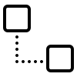
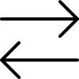
Projektanalyse – Folie 2
Functionality of Shila
Three Parts
Setup
Getting Shila ready to mediate between MPTCP and SCION
Connection establishment
Establish the connection between the client and server of a TCP application
Main-Flow and Sub-Flows
Data exchange
Operational mode once connection is up
Notes:
Functionality of Shila can be divided into three parts:
Setup: Shila is getting ready to mediate between MPTCP and SCION
Connection establishment:
Stage where the client of a TCP application reaches out to the server of a TCP application
It consists of the Main-Flow establishment, so the establishment of the initial connection, and then
of one or multiple Sub-Flow establishments.
Once the connection is established, Shila works in “operational mode”, rerouting the data exchanged
between client and server.
I will now illustrate this three parts based on a running example..

Slide 10
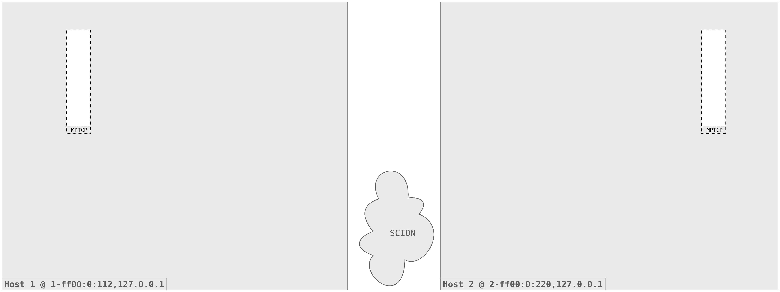
Projektanalyse – Folie 2
Functionality of Shila
Initial situation
Notes:
What we have here is the initial situation:
Two Hosts, Host 1 and Host 2
Connected to the SCION network
Both with support for MPTCP
The example we want to cover is a TCP Client on Host 1 connecting to a TCP Server on Host 2.

Slide 11
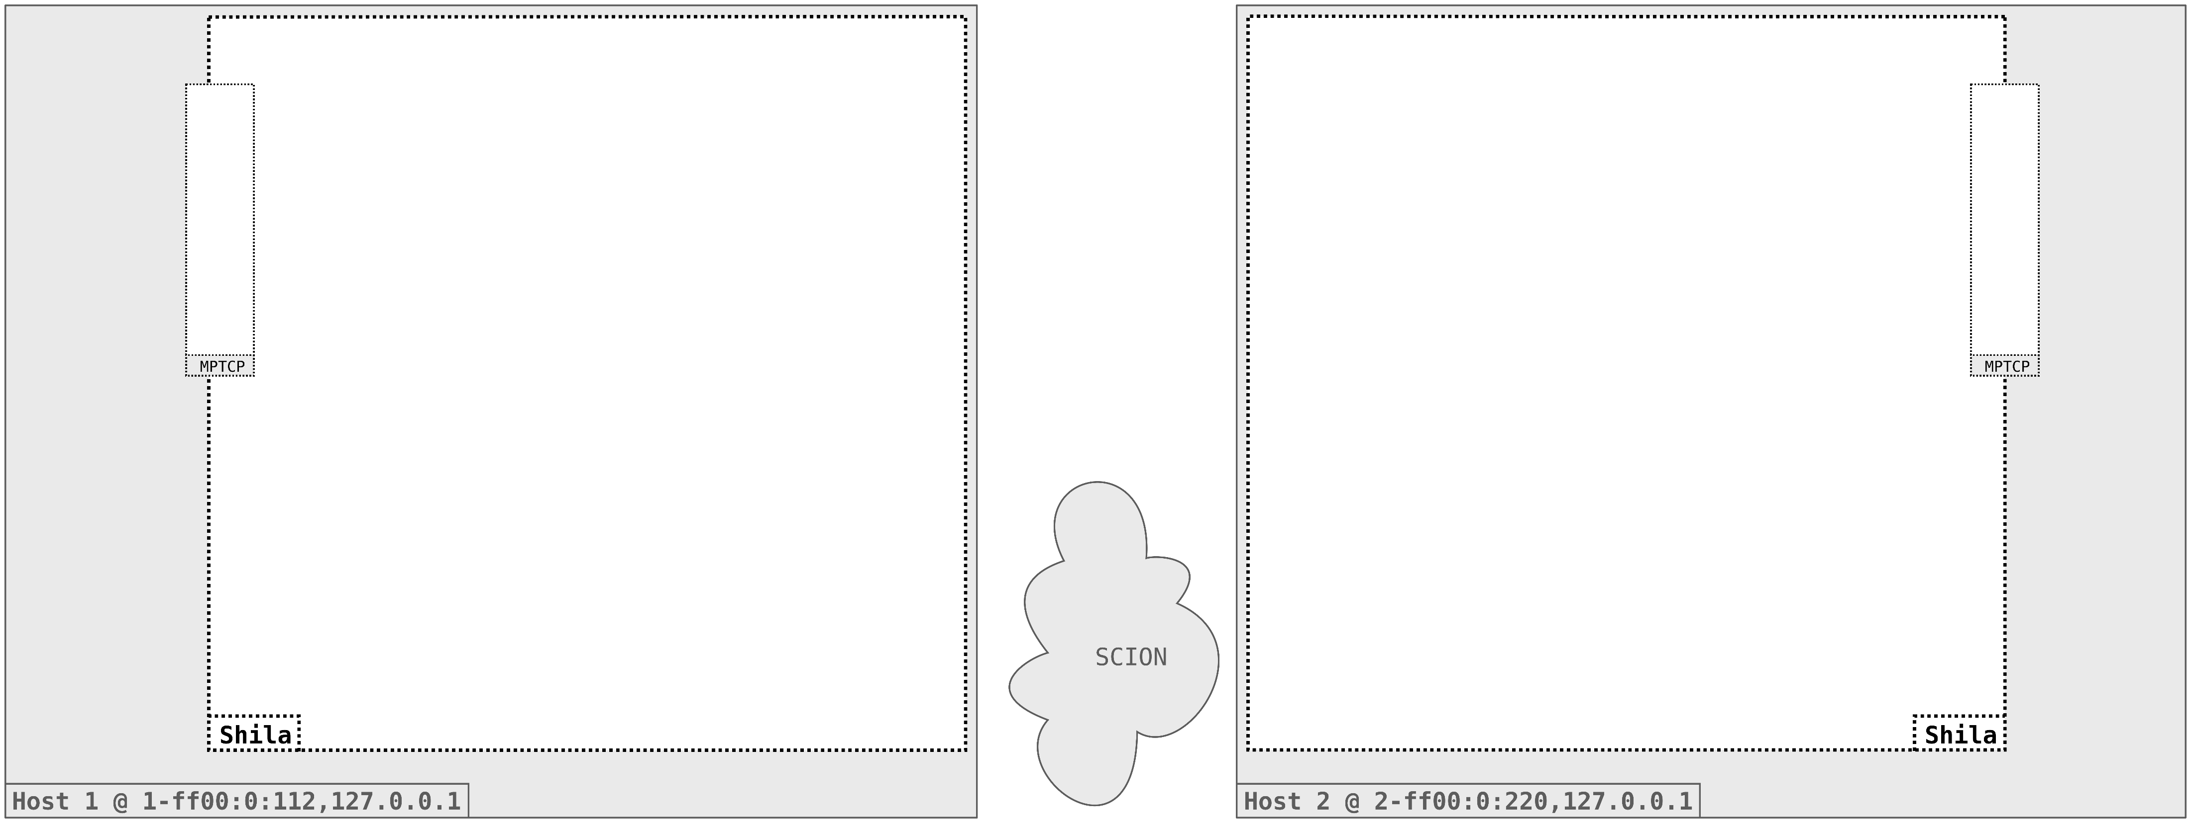
Projektanalyse – Folie 2
Functionality of Shila
Setup
Notes:
Start with the setup (Shila is getting ready to mediate between MPTCP and SCION)
We start Shila on both Hosts. Note that the setup is the same on both, it is sufficient to concentrate
just on the left instance.

Slide 12
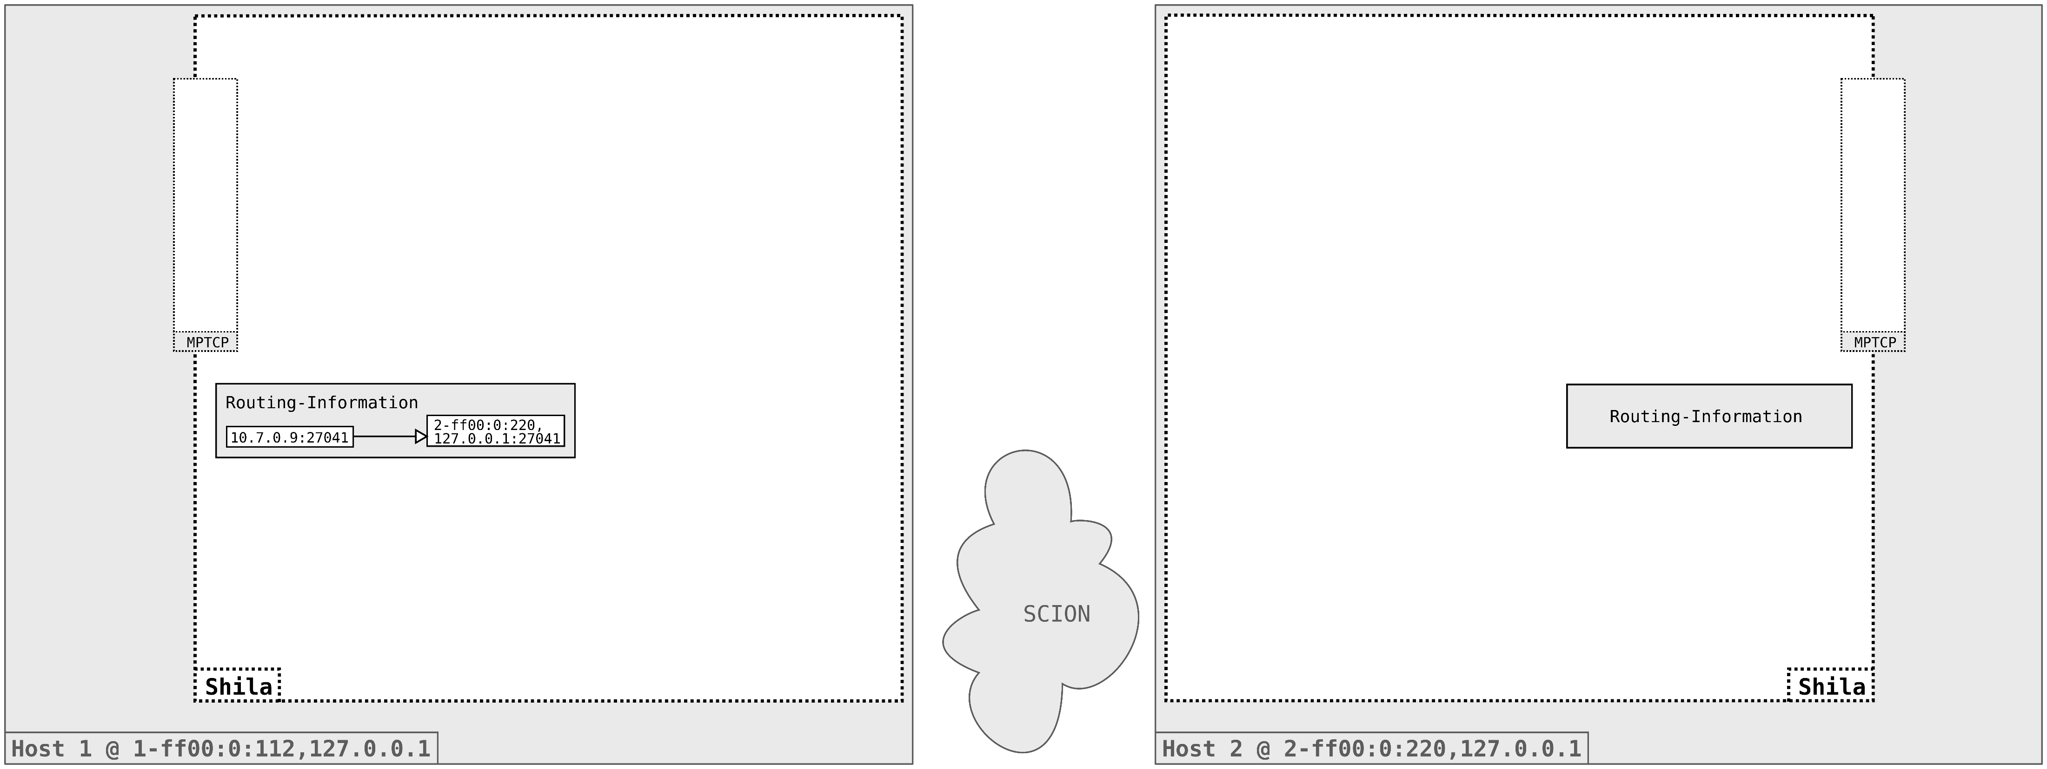
Projektanalyse – Folie 2
Functionality of Shila
Setup
Notes:
Routing Information is loaded
Contains the mapping from TCP destination address to SCION destination address.
We will later see how this mapping is used and why it is necessary.

Slide 13
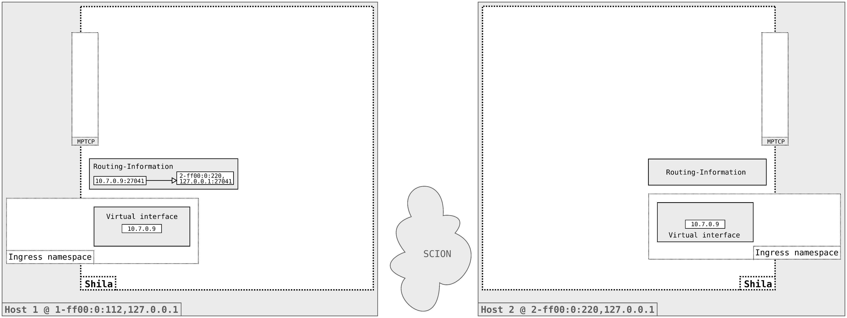
Projektanalyse – Folie 2
Functionality of Shila
Setup
Notes:
Allocation of ingress namespace
Creation of a single virtual interface with a default IP address.

Slide 14
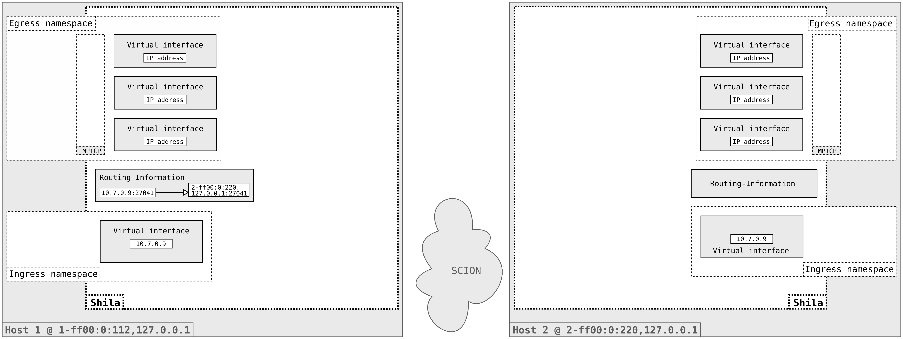
Projektanalyse – Folie 2
Functionality of Shila
Setup
Notes:
Then the egress namespace is allocated
In there, the default number of three virtual interfaces is created. This number can be chosen by the user.
The number of virtual network interfaces created corresponds later to the number of flows used for a single MPTCP connection.
So if for example just one interface is created, then we have just a simple TCP connection.
With three interfaces as we have here, we will have one Main-Flow and two Sub-Flows in the end.

Slide 15

Projektanalyse – Folie 2
Functionality of Shila
Setup
Notes:
As a last step of the setup, Shila creates the Contact-Server-Endpoint listening per default on the SCION port 7654.
This endpoint, as we will see soon, serves as an initial point of contact for Shila instances running on different hosts.
This concludes the setup part, Shila is now ready to receive and mediate traffic.

Slide 16
Projektanalyse – Folie 2
Functionality of Shila
Main-Flow Establishment
Notes:
We will now step through the Main-Flow establishment. As I said, this is the establishment of the first of possible
multiple flows of a single MPTCP connection between two endpoints.

Slide 17
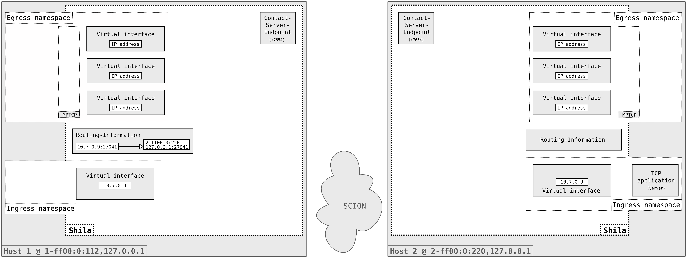
Projektanalyse – Folie 2
Functionality of Shila
Main-Flow Establishment
Notes:
Start of the TCP Server application in the ingress namespace of the Shila instance on Host 2.

Slide 18

Projektanalyse – Folie 2
Functionality of Shila
Main-Flow Establishment
Notes:
Binds to the virtual interface on, let's say, port 27041. This step is not recognized by Shila.

Slide 19
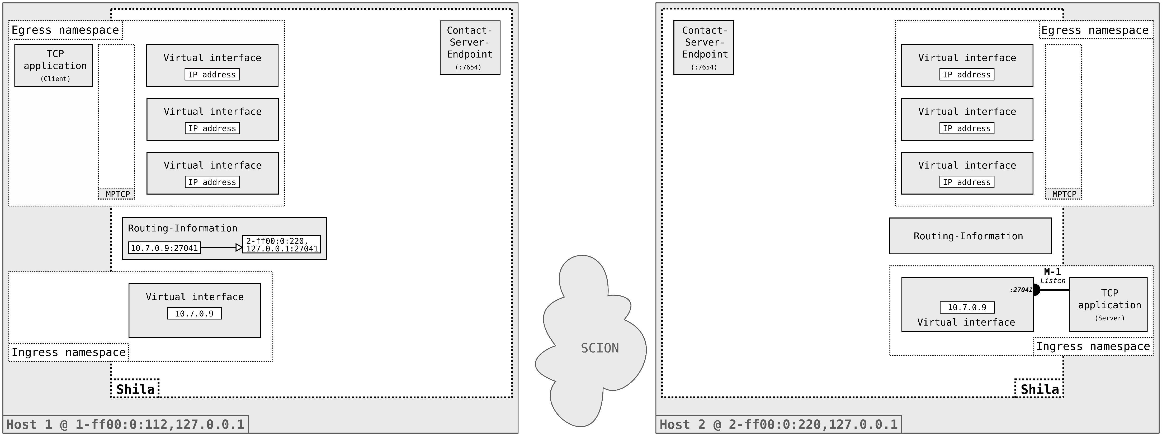
Projektanalyse – Folie 2
Functionality of Shila
Main-Flow Establishment
Notes:
The TCP Client instance is started in the egress namespace of the Shila instance on Host 1.

Slide 20

Projektanalyse – Folie 2
Functionality of Shila
Main-Flow Establishment
Notes:
It binds a socket to one of the virtual interfaces.
As soon as connected a very first datagram containing the SYN is sent out by the application and intercepted by Shila.

Slide 21
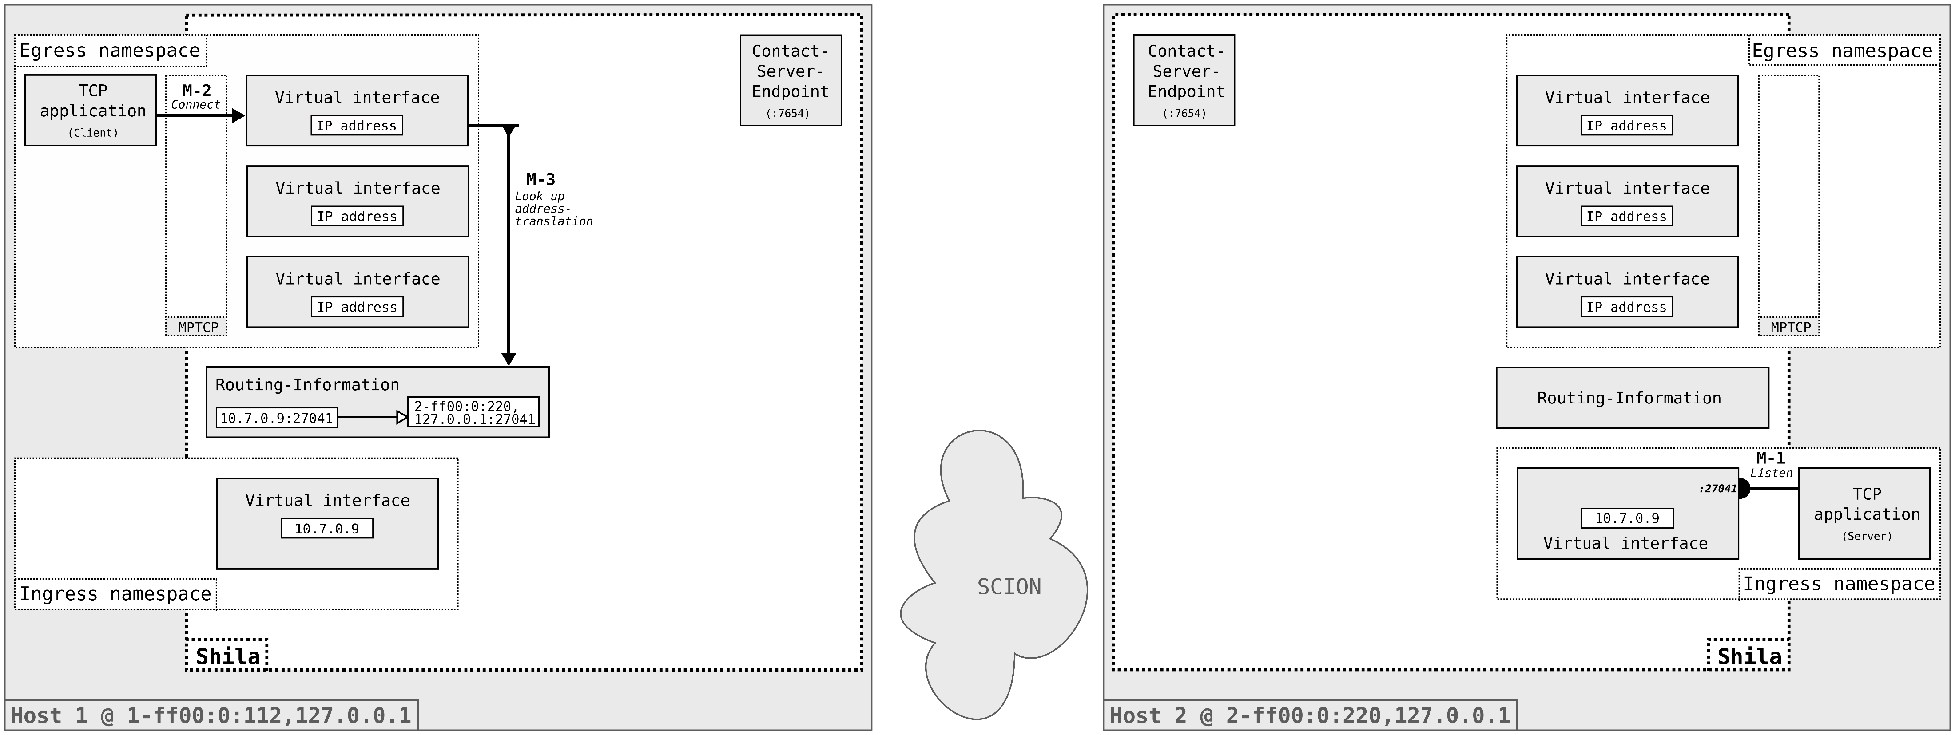
Projektanalyse – Folie 2
Functionality of Shila
Main-Flow Establishment
Notes:
Shila parses this datagram and extracts its destination address, namely 10.7.0.9.
(This is the IP address assigned to the virtual interface in ingress namespace of Host 2.)
Using the destination TCP address as a key, it extracts the destination SCION address from the Routing-Information.
For our example, this is the SCION address of Host 2.

Slide 22
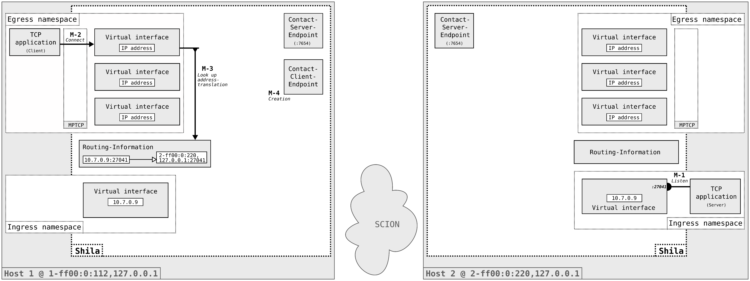
Projektanalyse – Folie 2
Functionality of Shila
Main-Flow Establishment
Notes:
With this information at hand, it creates a so-called Contact-Client-Endpoint…

Slide 23

Projektanalyse – Folie 2
Functionality of Shila
Main-Flow Establishment
Notes:
This Contact-Client-Endpoint then establishes a backbone connection to the Contact-Server-Endpoint listening in the Shila instance on Host 2.
Note: The SCION destination address is known from the Routing-Information.
For the port, a default one (7654) is used.

Slide 24
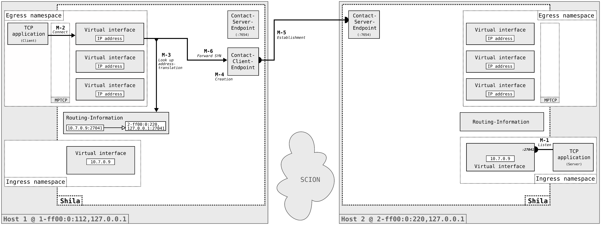
Projektanalyse – Folie 2
Functionality of Shila
Main-Flow Establishment
Notes:
Once the so-called Contact-Backbone-Connect is established, the datagram with the SYN is forwarded…

Slide 25

Projektanalyse – Folie 2
Functionality of Shila
Main-Flow Establishment
Notes:
…

Slide 26

Projektanalyse – Folie 2
Functionality of Shila
Main-Flow Establishment
Notes:
… to the ingress virtual interface on Host 2.
From there it is forwarded via the kernel networking to the listening TCP application.

Slide 27
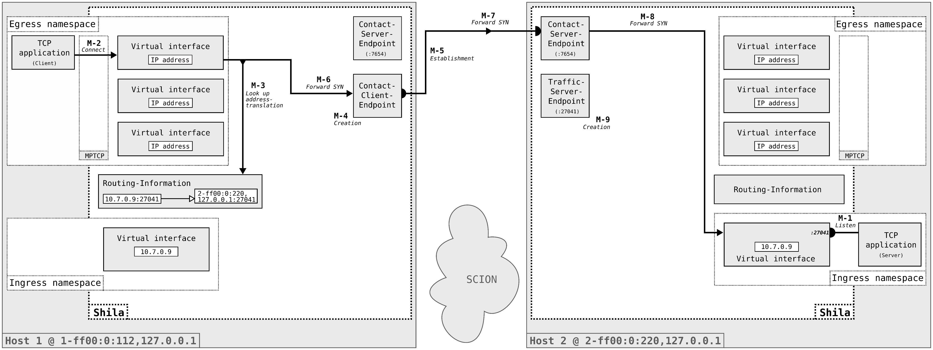
Projektanalyse – Folie 2
Functionality of Shila
Main-Flow Establishment
Notes:
Upon reception of the SYN datagram, Shila on Host 2 creates a so-called Traffic-Server-Endpoint listening on SCION port 27041.
The necessary information, that is, what port to listen on, was exchanged as part of the creation of the Contact-Backbone-Connection.
There is no need for Shila to parse the IP datagram on the receiving side.

Slide 28
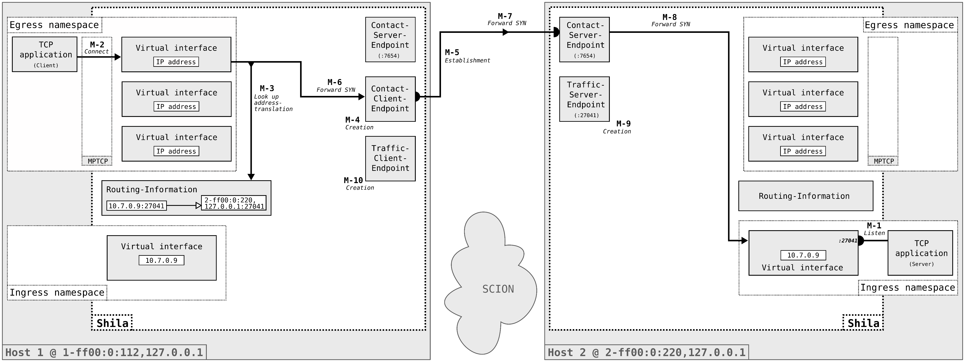
Projektanalyse – Folie 2
Functionality of Shila
Main-Flow Establishment
Notes:
Shila on Host 1 in the meantime creates the Traffic-Client-Endpoint…

Slide 29

Projektanalyse – Folie 2
Functionality of Shila
Main-Flow Establishment
Notes:
And the so-called Traffic-Backbone-Connection is established.

Slide 30
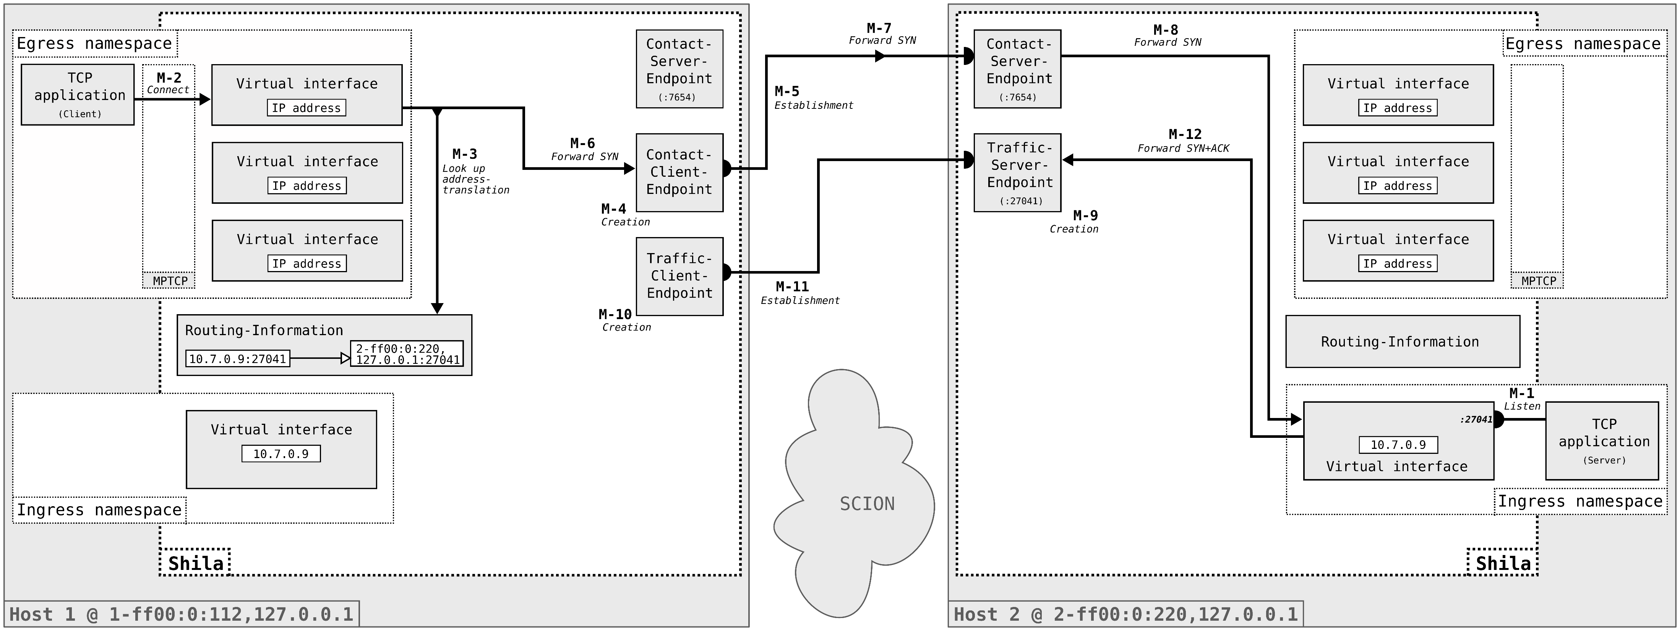
Projektanalyse – Folie 2
Functionality of Shila
Main-Flow Establishment
Notes:
In the meantime Shila intercepts the SYN+ACK of the TCP server application on Host 2 and routes it via the newly created Traffic-Backbone-Connection..

Slide 31

Projektanalyse – Folie 2
Functionality of Shila
Main-Flow Establishment
Notes:
…

Slide 32
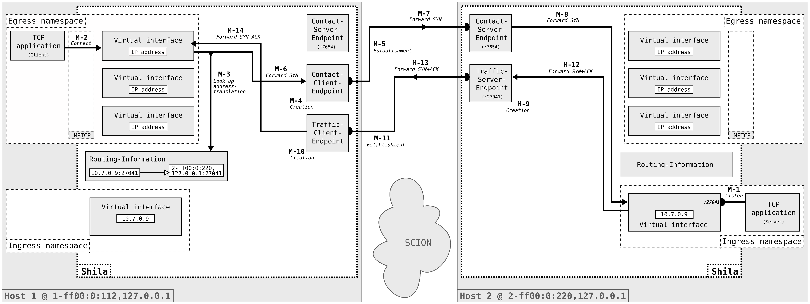
Projektanalyse – Folie 2
Functionality of Shila
Main-Flow Establishment
Notes:
..back to Shila on Host 1. There the SYN+ACK is forwarded through the respective virtual interface to the TCP client.
This concludes the establishment of the Main-Flow…

Slide 33
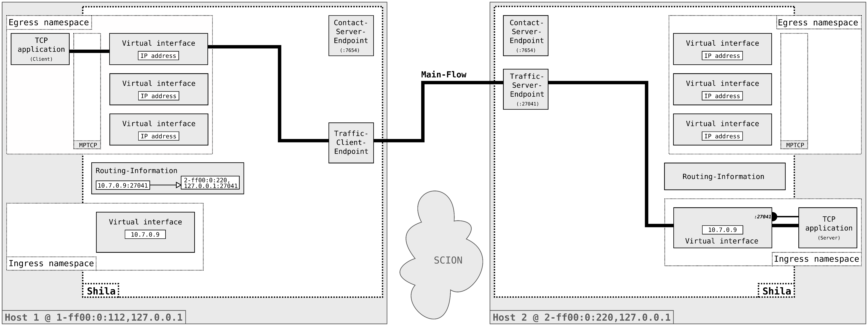
Projektanalyse – Folie 2
Functionality of Shila
Main-Flow Establishment
Notes:
..The Contact-Backbone-Connection and the associated endpoint (Contact-Client-Endpoint) is removed, and the data can be exchanged via the Main-Flow.

Slide 34
Projektanalyse – Folie 2
Functionality of Shila
Sub-Flow Establishment
Notes:
As soon as the Main-Flow is established, MPTCP starts to initiate further flows using the other available virtual interfaces in the egress namespace..
We call this flows Sub-Flow and I will now go through the steps of a Sub-Flow establishment. However, the most steps are similar to the establishment of a Main-Flow,
so I will therefore just mention the differences..

Slide 35

Projektanalyse – Folie 2
Functionality of Shila
Sub-Flow Establishment
Notes:
As I already said, a Sub-Flow is initiated by MPTCP itself and not by the application.

Slide 36
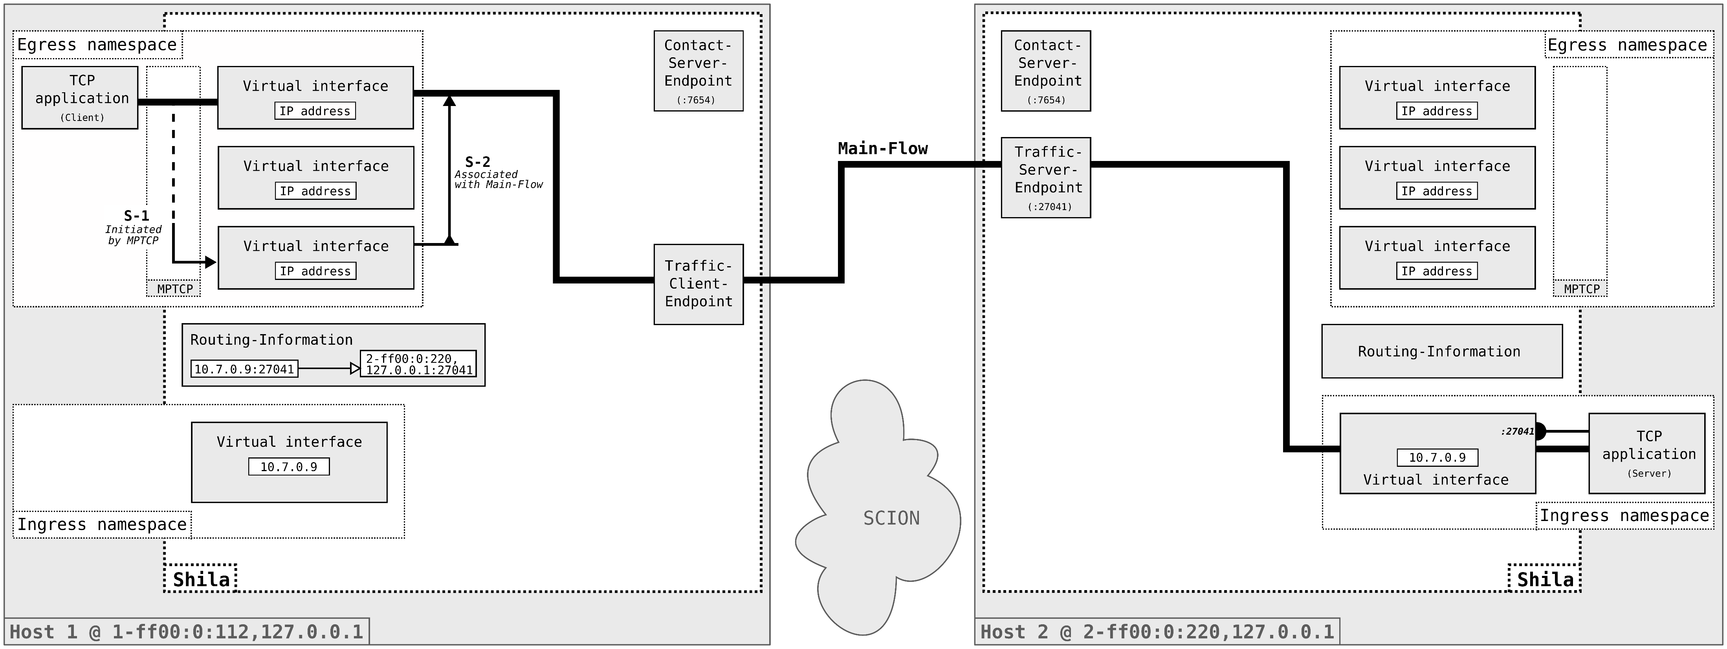
Projektanalyse – Folie 2
Functionality of Shila
Sub-Flow Establishment
Notes:
The SYN for the Sub-Flow is intercepted by Shila.
To get the destination SCION address she does not need to consult the Routing-Information again.
In MPTCP, every Sub-Flow is associated with a Main-Flow. Using this association Shila figures out the destination SCION address.

Slide 37
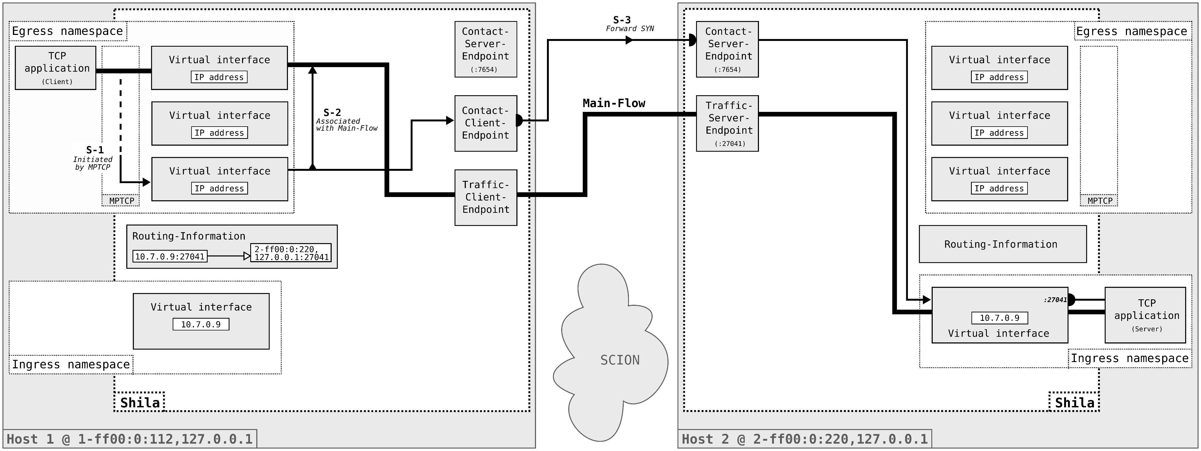
Projektanalyse – Folie 2
Functionality of Shila
Sub-Flow Establishment
Notes:
With the destination SCION address at hand Shila can contact its opposite instance and forward the SYN to the TCP Server application.

Slide 38
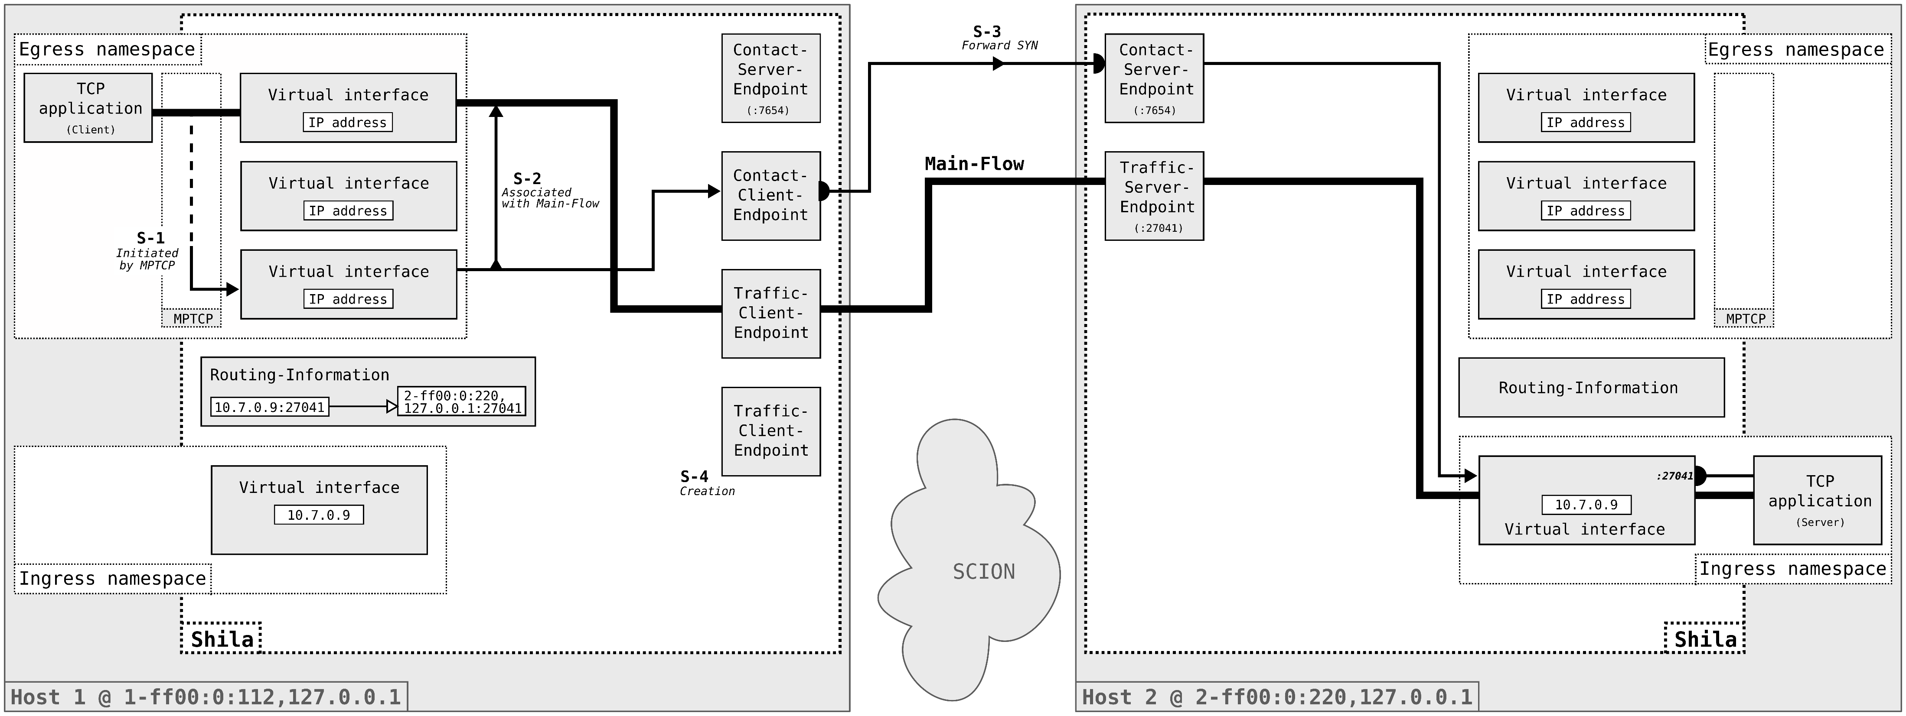
Projektanalyse – Folie 2
Functionality of Shila
Sub-Flow Establishment
Notes:
It creates a new Traffic-Client-Endpoint..

Slide 39
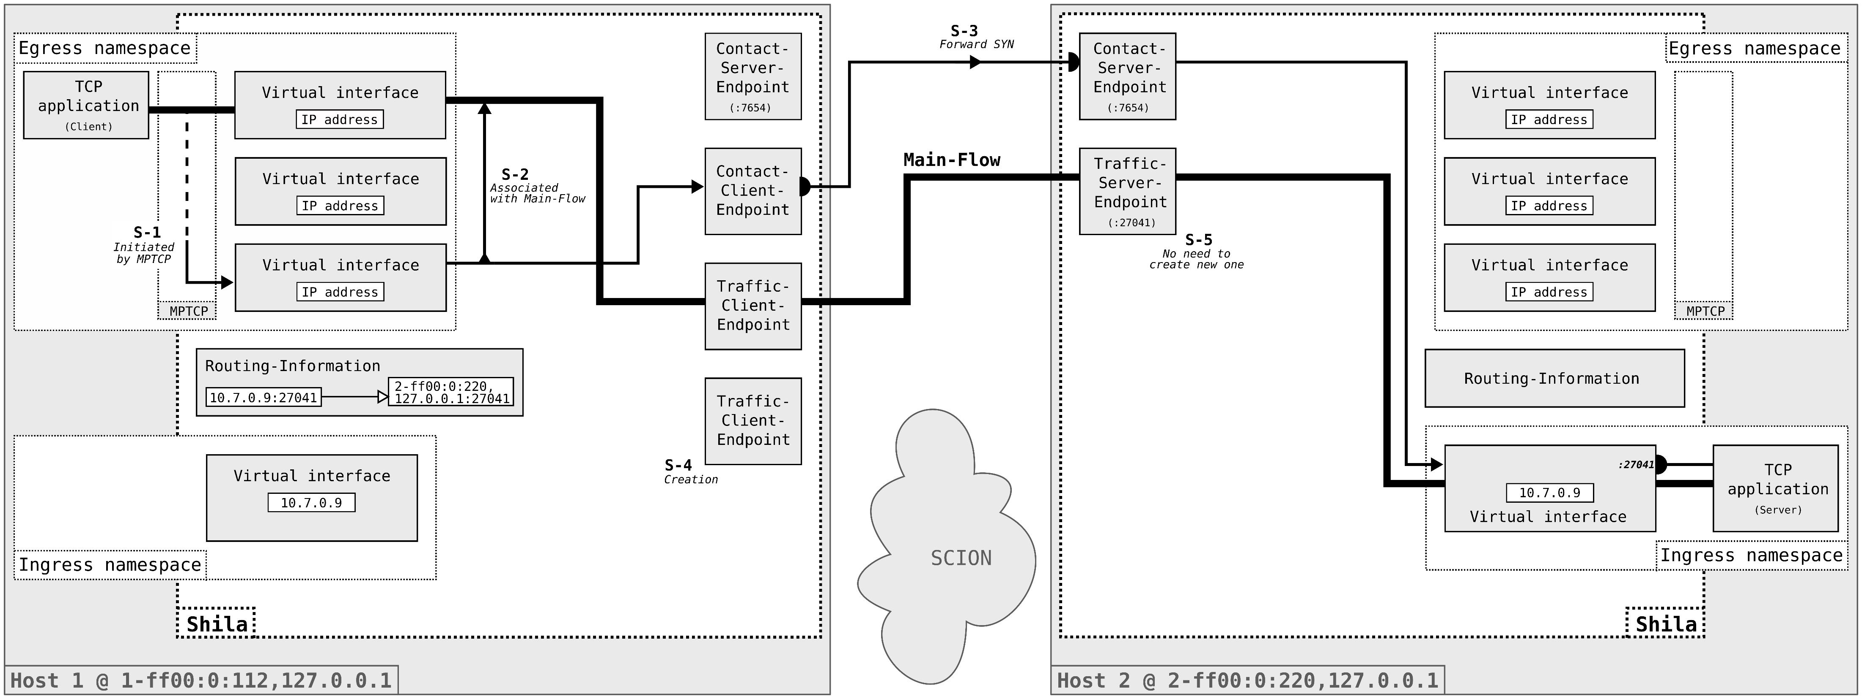
Projektanalyse – Folie 2
Functionality of Shila
Sub-Flow Establishment
Notes:
and..

Slide 40

Projektanalyse – Folie 2
Functionality of Shila
Sub-Flow Establishment
Notes:
Creates a new Traffic-Backbone-Connection to the already existing Traffic-Server-Endpoint.
Note that there is no need to create a new Traffic-Server-Endpoint on Shila Host 2.

Slide 41
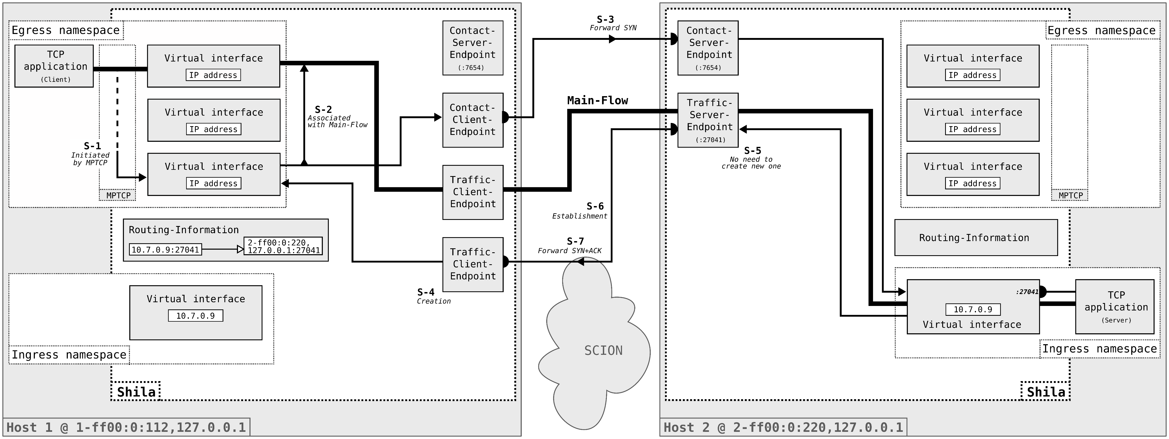
Projektanalyse – Folie 2
Functionality of Shila
Sub-Flow Establishment
Notes:
Once the Traffic-Backbone-Connection is established, the returning SYN-ACK can be forwarded through, towards the client TCP application.

Slide 42
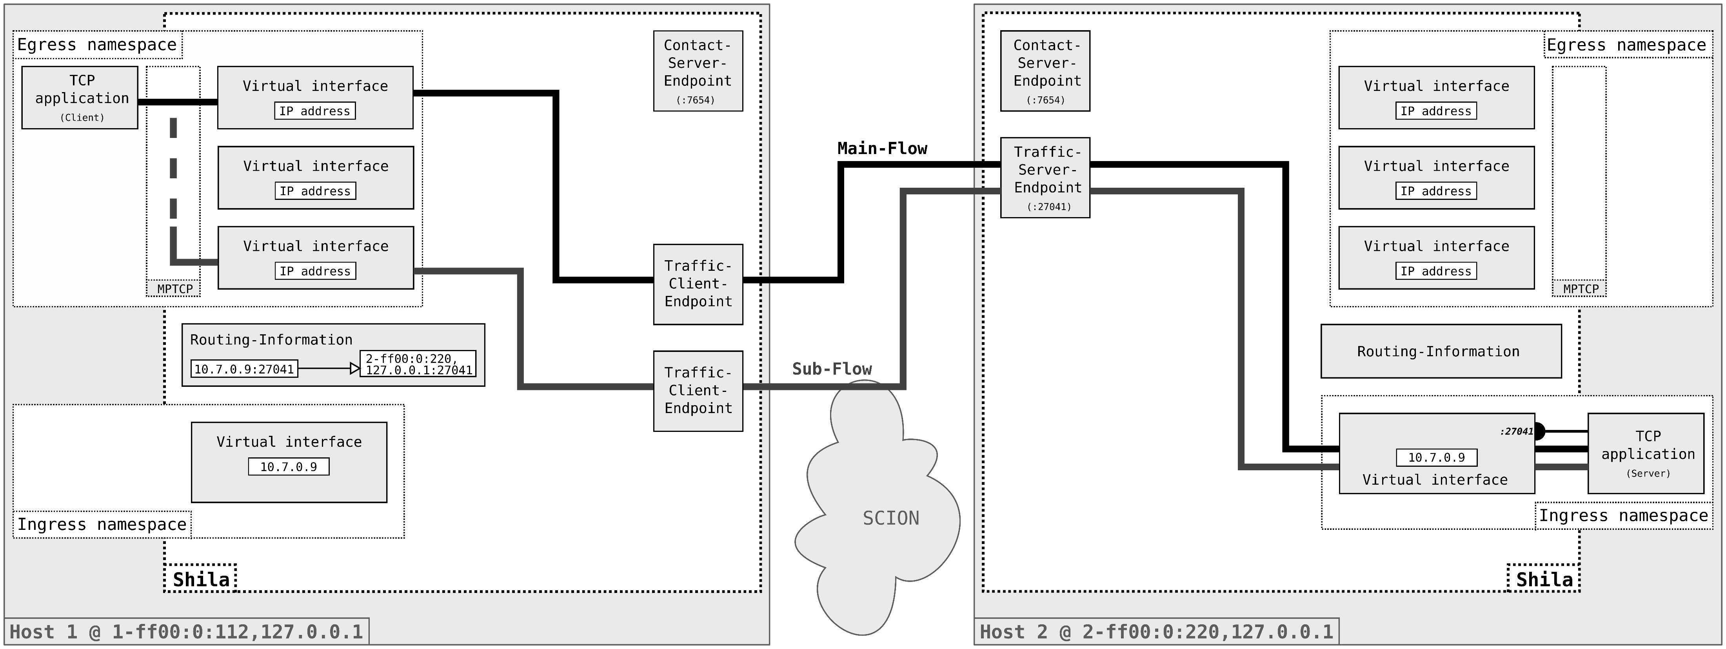
Projektanalyse – Folie 2
Functionality of Shila
Data Exchange
Notes:
This concludes the establishment of the Sub-Flow.
The MPTCP connection illustrated here now consists of two flows. The mechanisms of MTPCP decided on which flow to use during the data exchange.
Although theoretically possible, Shila does not affect the selection of the flow to be used.
(Shila could for example intentionally drop packets on a certain flow..)
Of course would MPTCP initiate a third flow over the yet unused virtual interface.
Shila maintains the flows as long as there is data flowing through. The Backbone-Connections and its corresponding Endpoints are removed if
there is no more data flowing.

Slide 43
Projektanalyse – Folie 2
On the menu
Introduction
Functionality of Shila
Performance evaluation
Future work
Notes:
So with an idea how Shila works, lets move on to the performance evaluation.

Slide 44


Projektanalyse – Folie 2
Performance evaluation
Questions of interest
How does the performance behave in relation to the
number of paths used for a connection?
How well does Shila perform compared to QUIC over SCION?
Notes:
Here, I would like to present the answers to two questions that I examined in the course of this performance analysis:
firstly:
How does the performance behave in relation to the
number of paths used for a connection?
and secondly:
How well does Shila perform compared to QUIC over SCION?

Slide 45
Projektanalyse – Folie 2
Performance evaluation
Setup
Infrastructure
Three custom ASes within the SCIONLab
Shorter inter-European and longer overseas connection
Measure
Goodput with iPerf3 as TCP application
Throughput computed offline from packet capture
Methodology
Data exchange for 30s between dinstinct ASes
Variation in the number of paths used (1,2,4,6,8)
10 repetitions per fixed set of parameters, random order
Notes:
To answer this questions I conducted measurements with the following setup:
As an infrastructure I used the SCIONLab with three custom ASes. I choose the attachment points for these three ASes such that I can represent shorter inter-European as well as longer overseas connections.
As a measure I recorded values for the goodput and the throughput. The measurement of goodput was done with iPerf3 as a TCP application, and the throughput I computed offline from the packet capturing.
I recorded the metrics for a 30s data exchange between two distinct custom ASes. Between the experiments I varied both the ASes and the number of paths used.
Every experiment I repeated 10 times and I did them in a random order.

Slide 46
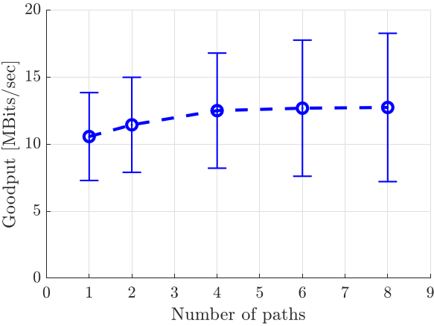
Projektanalyse – Folie 2
Performance evaluation
Result
How does the performance behave in relation to the number of paths used for a connection?
An increase in the number of paths leads to an increase of the average goodput.
Notes:
Let’s answer the first question:
As we can see in this plot here: Increasing the number of paths leads to an increase in the average goodput.
This is what one would expect, nevertheless this results serves as some sort sanity check
What I want to mention here is the relatively large deviation:
This comes from the different performances of the connections. Shorter inter-European connections achieved higher values than the longer oversea connections. However, the shape looked for all the same.

Slide 47

Projektanalyse – Folie 2
Performance evaluation
Result
Paths | Shila |  | QUIC over SCION
 | Goodput | Throughput | Goodput | Throughput
1 | 10.75 ± 3.28 | 17.45 ± 5.91 | 33.31 ± 3.28 | 36.82 ± 3.62
8 | 12.74 ± 5.53 | 19.37 ± 8.36 | - | -
MBits/s
$$≈2.6×$$
How well does Shila perform compared to QUIC over SCION?
Shila gets outperformed by QUIC over SCION with respect to goodput as well as overhead.
Notes:
To the second question, the comparison to QUIC over SCION.
Unfortunately got Shila outperformed for both measures, Goodput as well as Overhead.
QUIC over SCION achieves a goodput that is about 2.6 times higher than the one achieved with Shila using eight paths. One reason, for this is that the data that
is sent with MPTCP over SCION makes a detour through the kernel back to the userland application Shila on both endpoints. This increases the round-time-time what
Itself has a negative impact on the goodput.
The verdict is also clear on the overhead: while QUIC over SCION works with an overhead of about 10%, MPTCP over SCION has an overhead of about 30%.
Of course such results do not make friends but Shila is willing to improve and develop in the future, which brings me to the last part of my presentation..

Slide 48
Projektanalyse – Folie 2
On the menu
Introduction
Functionality of Shila
Performance evaluation
Future work
Notes:
The future work.

Slide 49


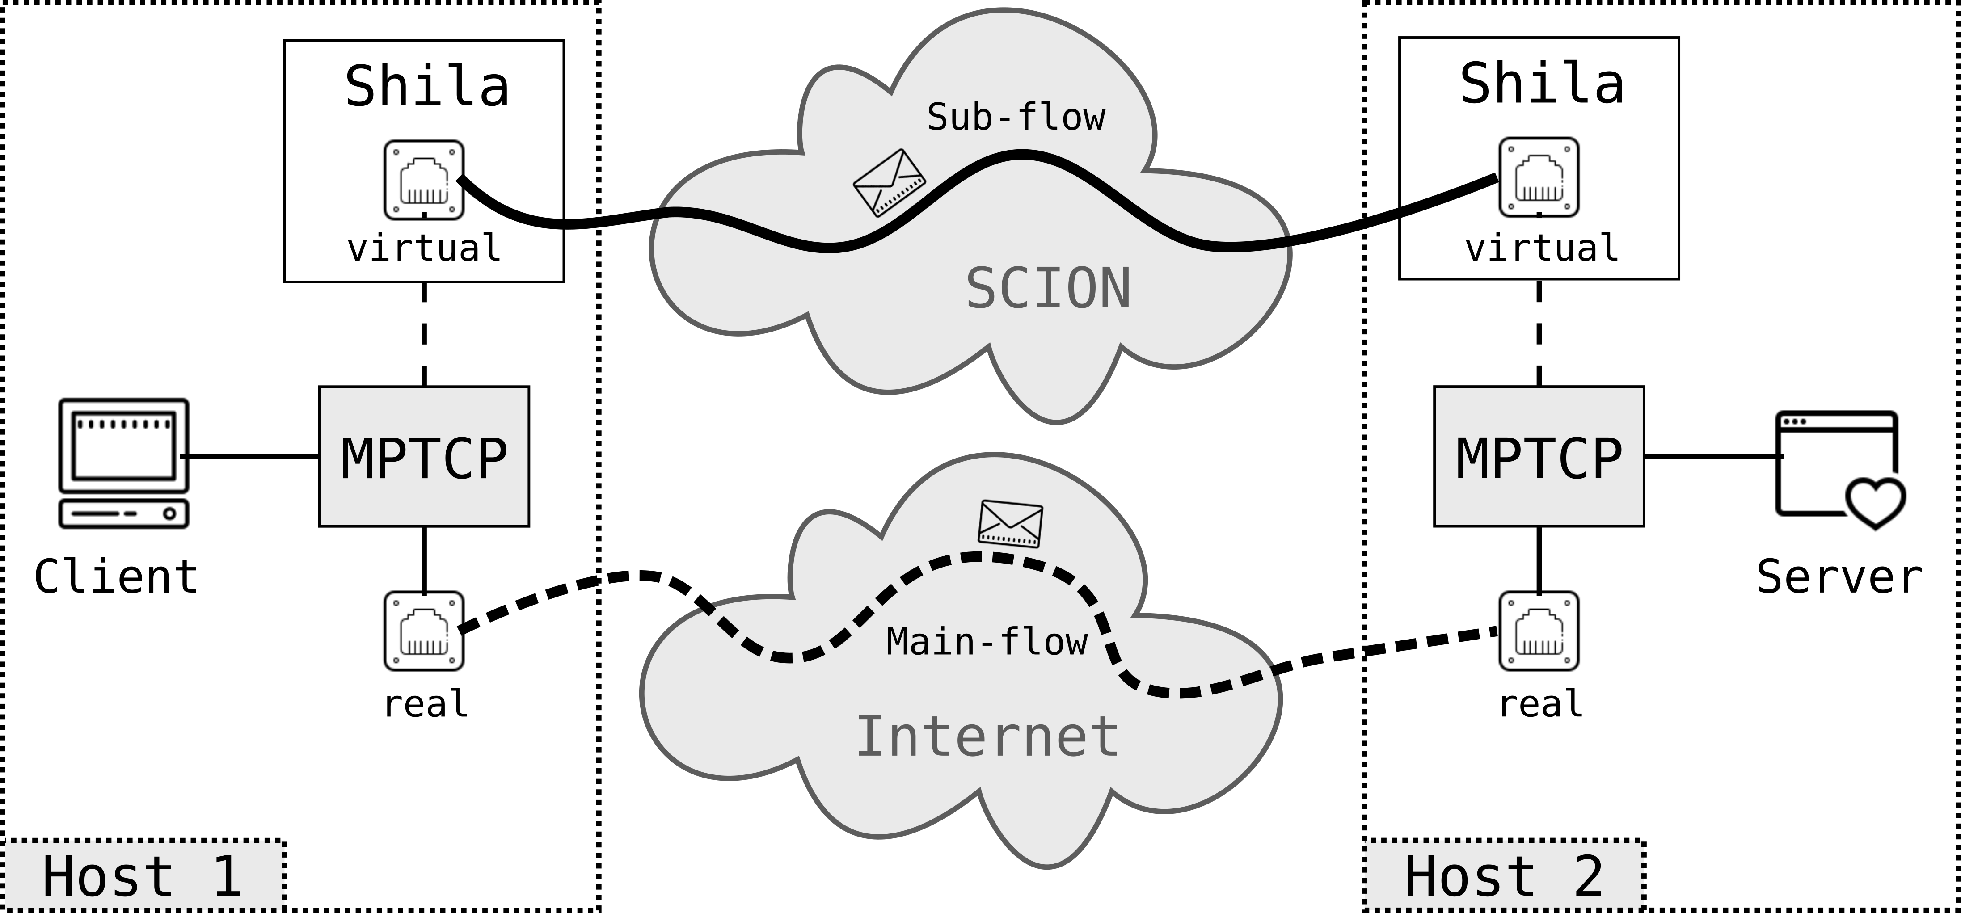

Projektanalyse – Folie 2
Future work
What is next?
Conduction of revision cycles
Improve implementation of Shila
Further testing
Side-by-side approach
Main-flow over conventional Internet
Sub-flow(s) over SCION
Addition of flexibility
Provide mapping betwenn TCP and SCION destination address upon connection establishment
Remove need for namespaces
Notes:
For further work on my thesis one should consider the following points:
Conduction of revision cycles: The implementation of Shila has still in some sort prototype character. Further testing and revision cycles should increase not just the quality but also the performance of the implementation.
Addition of flexibility: In current state, user have to supply the mapping from TCP to SCION destination addresses upon start-up of Shila. This is not really practicable, and the goal should be
to find and implement an approach which is more flexible. (One possible approach for example, which I could think of would be to provide the necessary option via IP socket options.)
As a last point I would like to mention a slightly different direction in which the journey of Shila could go. Instead of using her capabilities only for data exchange via MPTCP over SCION, a side-by-side approach is also conceivable. The Main-Flow of an MPTCP connection goes over the conventional Internet. Whereas the Sub-Flows are escorted by Shila through the SCION network.
This approach does not interfere with a users known working environment but facilitates the development of SCION. Users could benefit from the better internet architecture without even
realizing that they are using it.
With this outlook I reached the end of my presentation. Thank you.

Slide 50
Thank you.

Slide 51
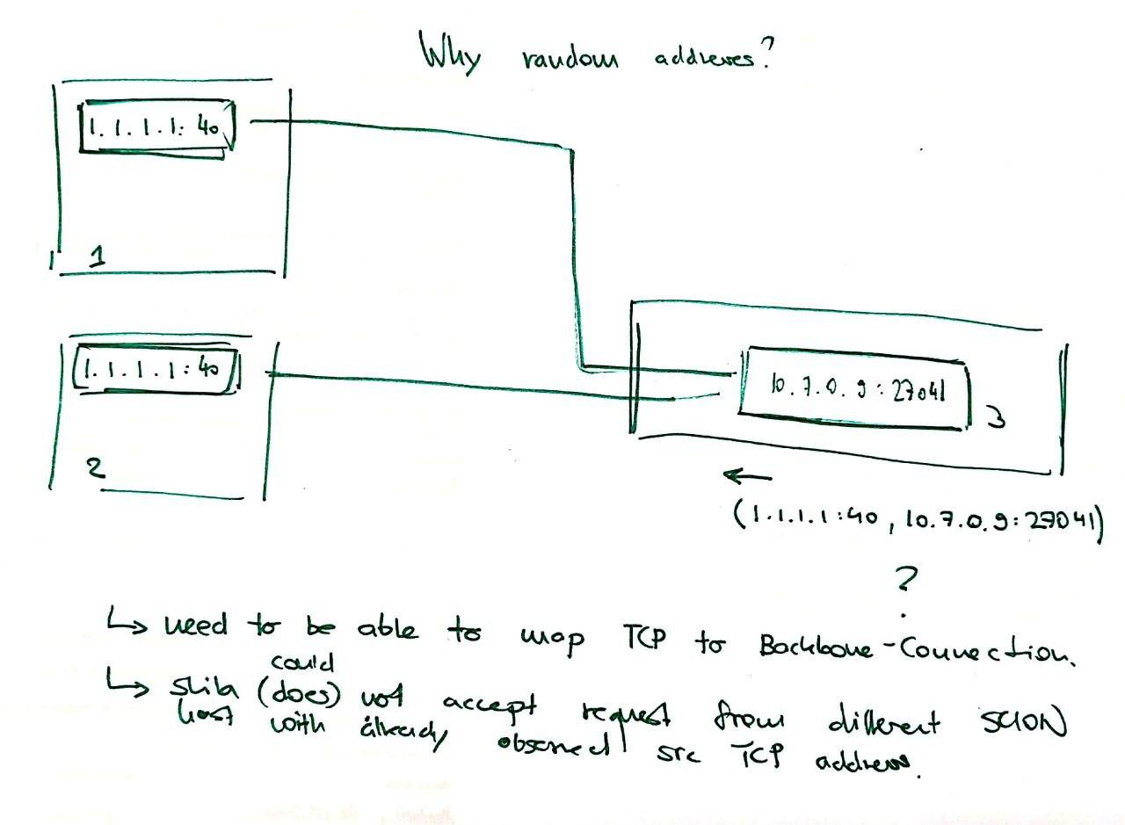
Projektanalyse – Folie 2
Notes
Random Egress IP’s

Slide 52
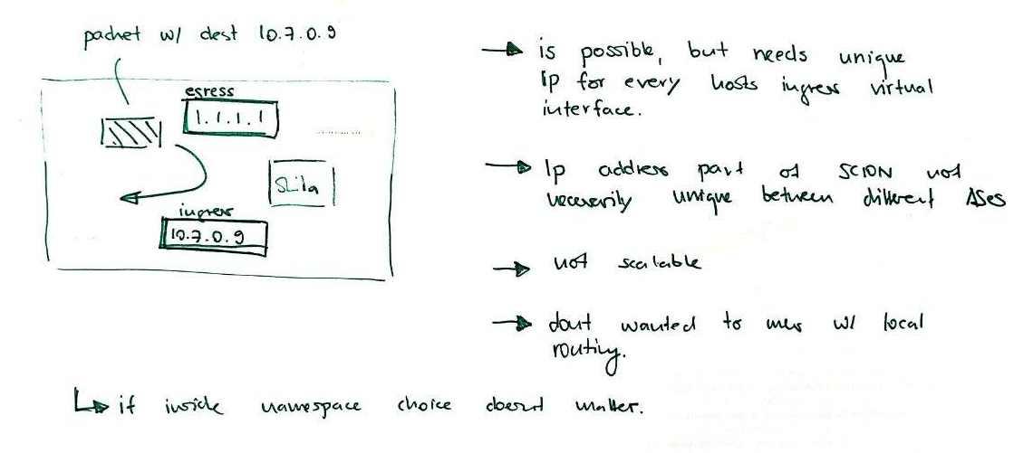
Projektanalyse – Folie 2
Notes
Why namespaces?

Slide 53

Shila as a girls’ name means ”blind”. Shila is a varian form of Sheila (Irish, Gaelic): version of Sile.
STARTS/ENDS WITH Sh-, -la

